Slide 1

DriverPass System Analysis
Mohamed Babiker
Notes:
[No speaker notes required for this slide.]

Slide 2

System Requirements
Functional Requirements
Users can schedule Driving Lessons
Users can log in and access practice tests
Nonfunctional Requirements
Users can have unique username and passwords
Cloud based instead of physical hosted servers
Notes:
We have defined a set of functional and nonfunctional criteria for the DriverPass system that perfectly suit DriverPass's goals and vision for the driving instruction platform. These are the chosen functional requirements:
Driving Lessons may be Scheduled by Users: The system makes arranging driving lessons easier by letting users choose their favorite days, times, and instructors. This criteria supports DriverPass's primary goal of giving clients quick and easy booking alternatives that improve their overall experience.
Logging in allows users to access practice exams: For online driver training to be successful, users must be able to log in and access practice exams. This functional need is consistent with DriverPass's objective of providing thorough driving test preparation resources, guaranteeing clients have access.
The chosen nonfunctional criteria are also tailored to DriverPass's particular requirements:
Users can create their own usernames and passwords: By requiring that each user have a distinct set of login credentials, this requirement helps to increase security and privacy. It supports DriverPass's goal of protecting user data and preventing unwanted access, boosting the platform's overall credibility.
Cloud-based servers as opposed to those housed on-site: The decision to use a cloud-based architecture rather than physically housed servers supports DriverPass's objective of making the system accessible at all times and from any location. This nonfunctional need takes care of the needs for scalability and flexible accessibility, allowing users to access the system via a variety of devices while assuring dependable performance and less operational complications.

Slide 3
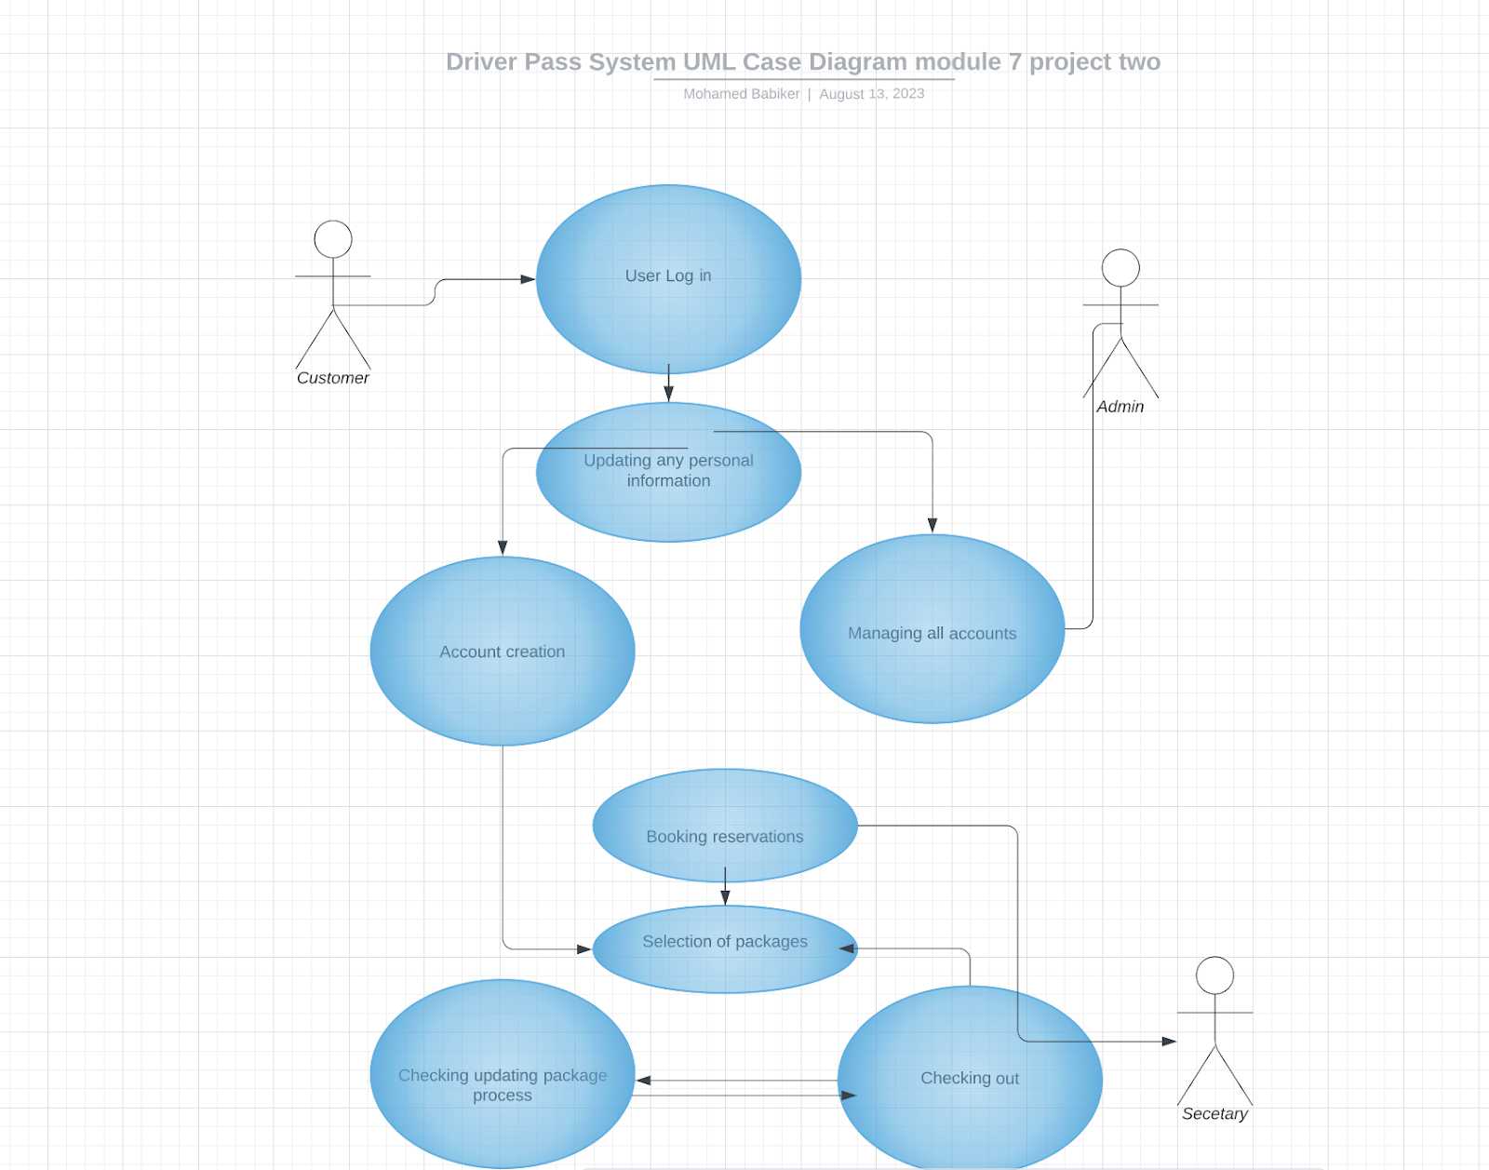
Use Case Diagram
Notes:
Parallel to this, we come across other user positions in this system, such as the administrator, clients, DMV, and teachers. The activities in this environment are similar to those in the preceding example, with a focus on scheduling, receiving shipments, arranging appointments, and verifying operations.
A logical series of tasks that illustrate the interconnectivity of various activities emerges, mirroring the previous narrative. The symmetry is clear, emphasizing how various features were seamlessly orchestrated to improve user interactions and expedite procedures.

Slide 4
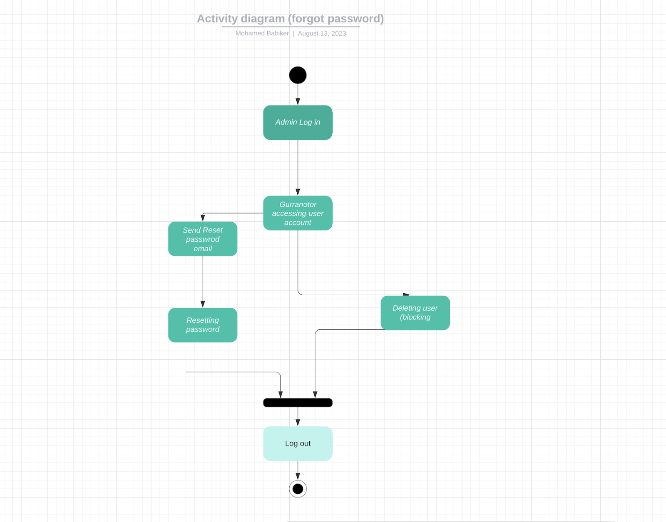
Activity Diagram
Notes:
The user login and password resetting process is at the core of the activity diagram I created for the system. This use case covers the essential actions users take to log into the platform and control their credentials. By avoiding technical jargon, I've tried to ensure clarity while making the explanation more understandable to a wider audience.
The user's trip is depicted in the diagram, which begins when they enter their login information (username and password). Users are given access to a number of functions, such as viewing training progress and appointments, after successfully logging in. The system also provides the functionality required for password resets. Customers of DriverPass and other users are given the ability to change their own passwords, which satisfies their need for self-service ease.

Slide 5
Security
Secure access may be obtained by using strong username/password authentication.
Advanced encryption techniques are used to store encrypted user passwords.
Controlled Password Reset: Establish a safe procedure for password resets that includes identity proofing.
Assign roles to users for restricted data access and system functioning using role-based access.
Notes:
Our approach to designing the DriverPass system includes a wide variety of security features that deal with different aspects of data protection and system integrity. Priority is given to user authentication, focusing on strong access control methods that allow only authorized users to interact with the system. We utilize sophisticated encryption techniques to store passwords securely to protect user accounts and reduce the danger of illegal access to critical data. We've devised a safe procedure for password resets that rigorously verifies identification in order to prevent any potential misuse. In order to maintain an organized and safe user experience, we've included role-based access, providing different user roles with varied rights.

Slide 6
System Limitations
Financial Constraints: Budget restrictions may limit the breadth of system improvements by preventing the development and upkeep of sophisticated features.
Dependence on Developers: The system is dependent on developer intervention to upgrade packages or add new features, which might cause delays in adjusting to changing user demands.
Allowing customers to select individual drivers can lead to scheduling conflicts or an unequal distribution of appointments, which might have an impact on the reliability and availability of the system.
many Concurrent Tests: If several users attempt to take many tests simultaneously, the system's performance may be impacted, which might result in resource conflict and system failures.
Notes:
While there are many advantages to our design for the DriverPass system, it's also crucial to recognize some drawbacks. Budget restrictions could prevent the system from supporting all planned functionality by preventing the installation of more sophisticated features. Furthermore, the system's ability to change packages or add new components depends on developer involvement, which might postpone reacting to changing user requirements. Giving customers the option to choose unique drivers could complicate scheduling and cause resource imbalances, which could jeopardize the stability of the system. Additionally, if several users attempt to run several tests at once, the system's speed may be hampered, perhaps resulting in delays or even system failures. As we continue to build and improve the DriverPass system, it is crucial to take these restrictions into account.

